Slide 1
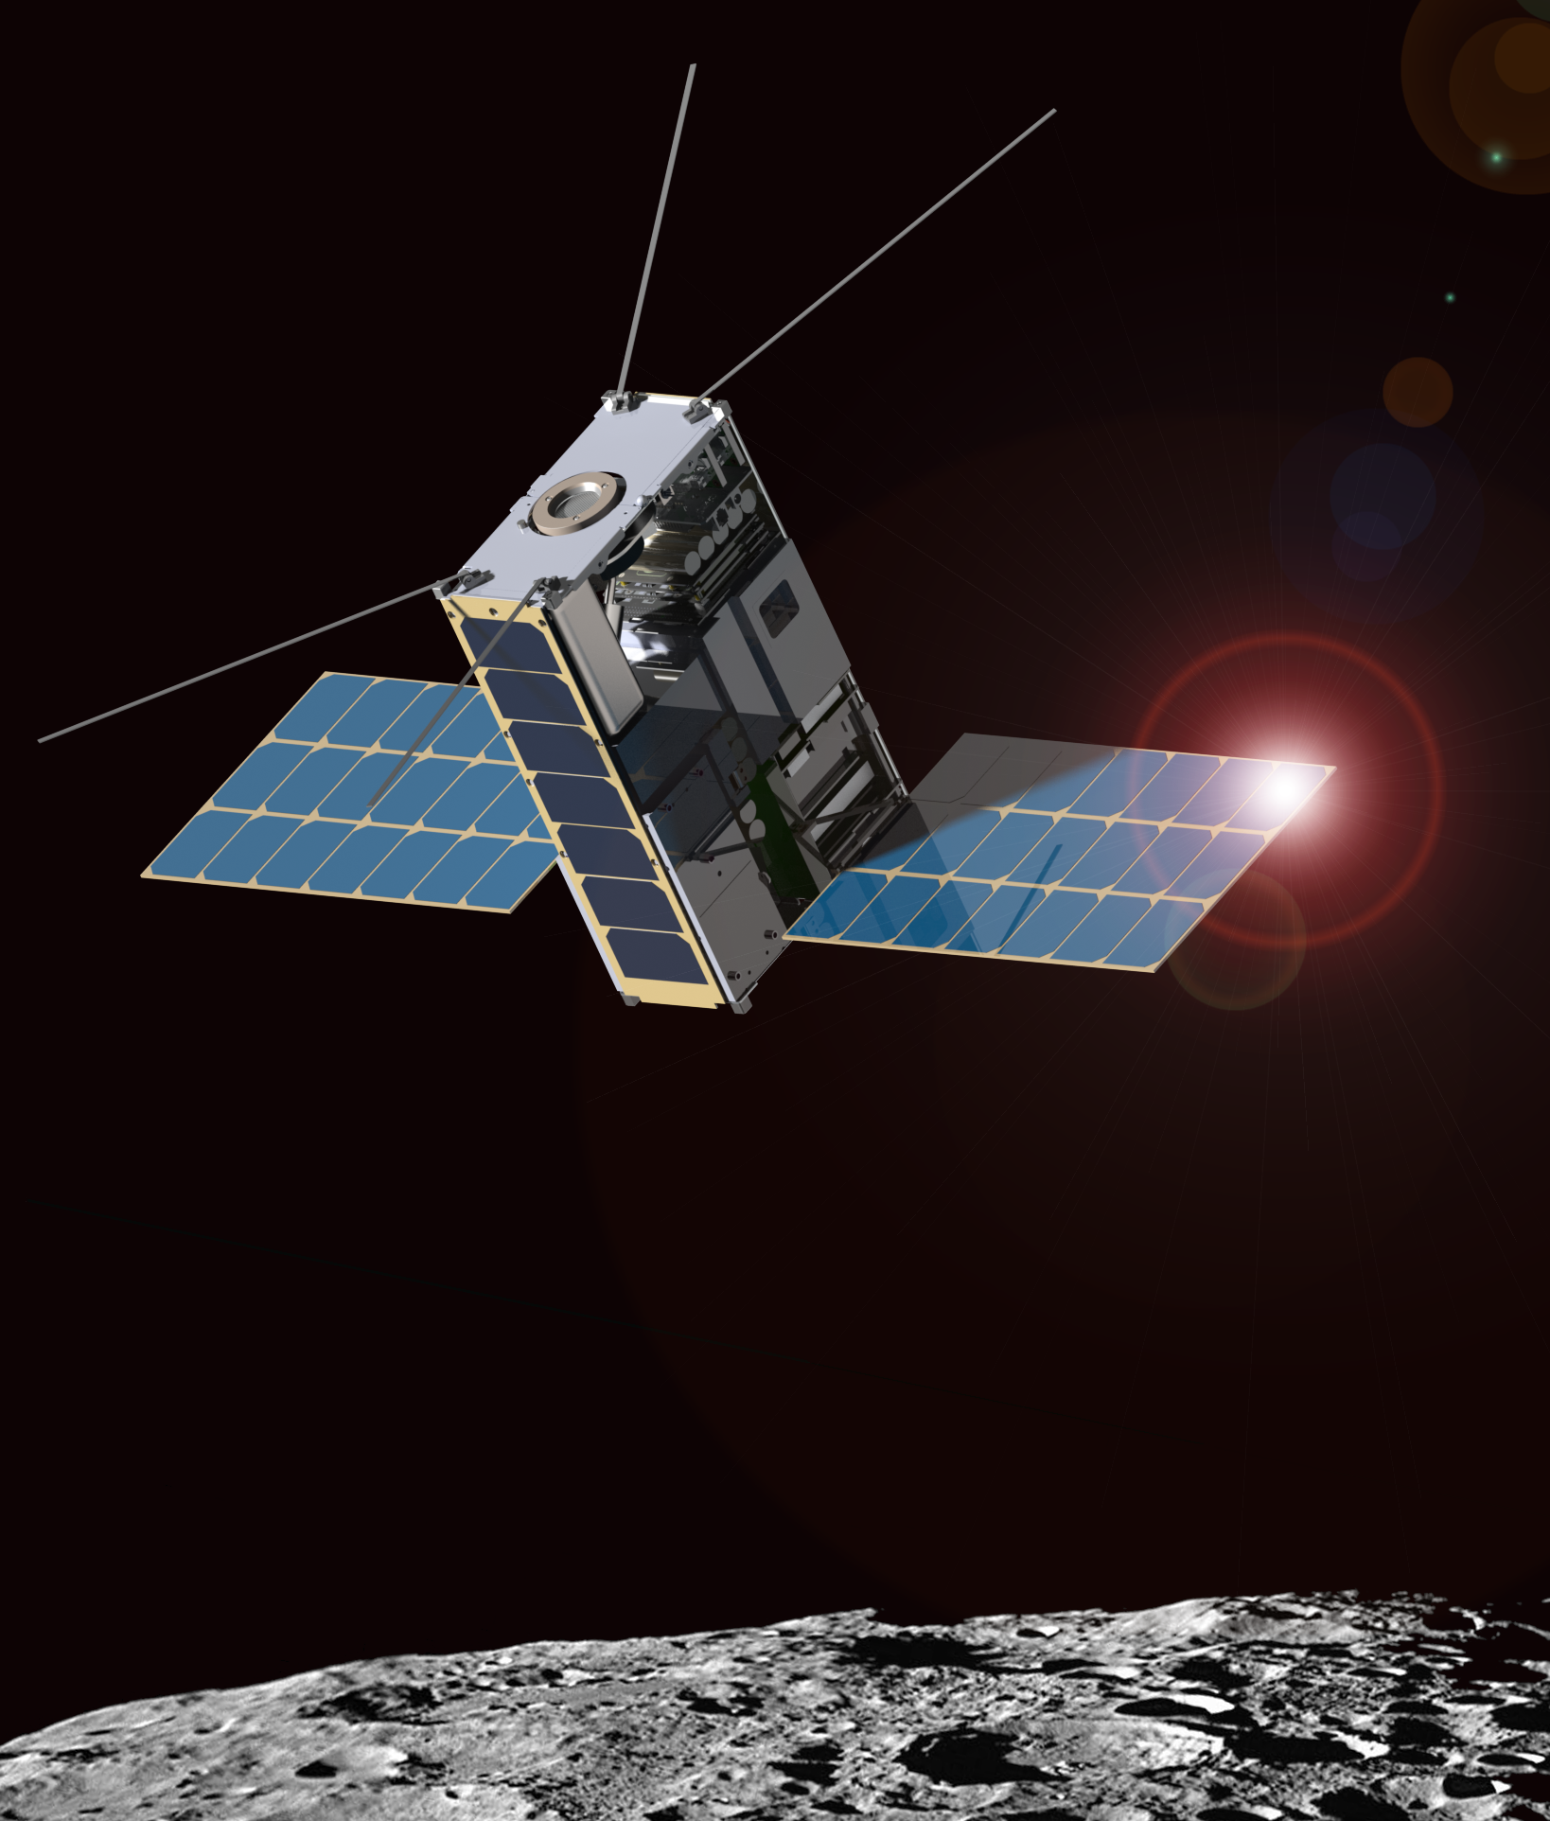
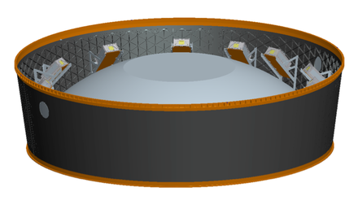
Lunar Ice Cube Orbiter:
Lunar Volatile Dynamics from a First Generation Deep Space CubeSat
P.E. Clark, CalTech/Jet Propulsion Laboratory, Science PI
B. Malphrus, Morehead State University, PI
NASA/GSFC Payload: D. Reuter, T. Hurford, R. MacDowall, N. Petro, W. Farrell, C. Brambora, D. Patel, S. Banks, P. Coulter
NASA/GSFC Flight Dynamics: D. Folta, P. Calhoun
Morehead State University Bus, Mission Ops, Ground Communication: B. Twiggs, Jeff Kruth, Kevin Brown, R. McNeill
Busek: M. Tsay, V. Hruby
Vermont Technical College, Flight Software: Carl Brandon, Peter Chapin
National Aeronautics and Space Administration
Jet Propulsion Laboratory
California Institute of Technology
Pasadena, California
www.nasa.gov
With JPL and non-JPL authors: © 2015. All rights reserved.
Government sponsorship acknowledged.
EM1 Deployment System for the ‘lucky 13’
Jet Propulsion Laboratory
California Institute of Technology

Slide 2
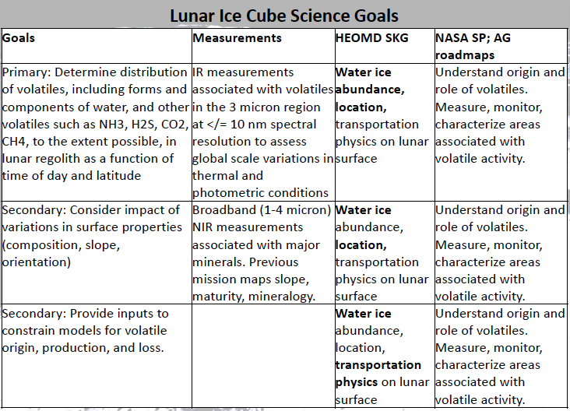

Slide 4
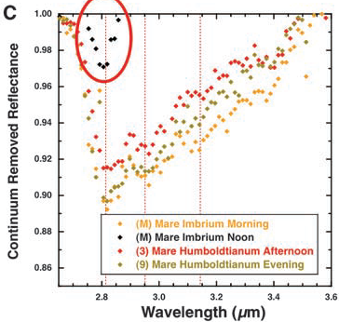
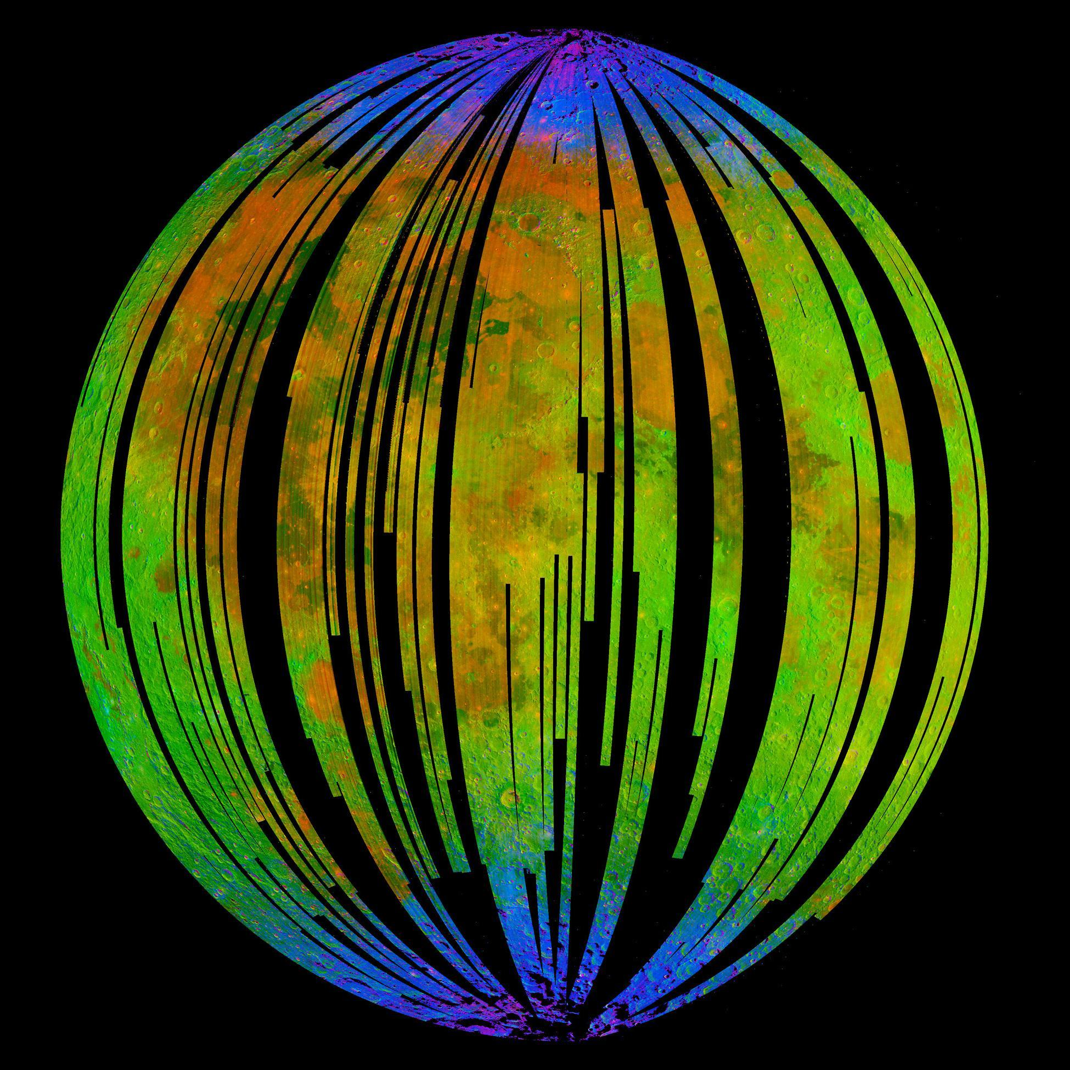
Lunar IceCube versus Previous Missions
Mission | Finding | IceCube
Cassini VIMS, Deep Impact | surface water detection, variable hydration, with noon peak absorption | water & other volatiles, fully characterize 3 μm region as function of several times of day for same swaths over range of latitudes w/ context of regolith mineralogy and maturity, radiation and particle exposure, for correlation w/ previous data
Chandrayaan M3 | H2O and OH (<3 microns) in mineralogical context nearside snapshot at one lunation
LCROSS | ice, other volatile presence and profile from impact in polar crater
LP, LRO, LEND LAMP DVNR LOLA LROC, LADEE | H+ in first meter (LP, LEND) & at surface (LAMP) inferred as ice abundance via correlation with temperature (DIVINER), PSR and PFS (LROC, LOLA), H exosphere (LADEE)
Early evidence for diurnal variation trend in OH absorption by Deep Impact (Sunshine et al. 2009) which will be geospatially linked by Lunar IceCube.
M3 ‘snapshot’ lunar nearside indicating surface coating OH/H₂O (blue) near poles (Pieters et al, 2009)

Slide 5
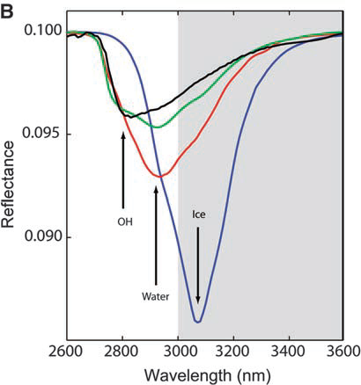
Species | μm | description
Water Form, Component
water vapor | 2.738 | OH stretch
 | 2.663 | OH stretch
liquid water | 3.106 | H-OH fundamental
 | 2.903 | H-OH fundamental
 | 1.4 | OH stretch overtone
 | 1.9 | HOH bend overtone
 | 2.85 | M3 Feature
 | 2.9 | total H2O
hydroxyl ion | 2.7-2.8 | OH stretch (mineral)
 | 2.81 | OH (surface or structural) stretches
 | 2.2-2.3 | cation-OH bend
 | 3.6 | structural OH
bound H2O | 2.85 | Houck et al (Mars)
 | 3 | H2O of hydration
 | 2.95 | H2O stretch (Mars)
 | 3.14 | feature w/2.95
adsorbed H2O | 2.9-3.0 | R. Clark
ice | 1.5 | band depth-layer correlated
 | 2 | strong feature
 | 3.06 | Pieters et al
Other Volatiles
NH3 | 1.65, 2. 2.2 | N-H stretch
CO2 | 2, 2.7 | C-O vibration and overtones
H2S | 3
CH4/organics | 1.2, 1.7, 2.3, 3.3 | C-H stretch fundamental and overtones
Mineral Bands
pyroxene | 0.95-1 | crystal field effects, charge transfer
olivine | 1, 2, 2.9 | crystal field effects
spinels | 2 | crystal field effects
iron oxides | 1 | crystal field effects
carbonate | 2.35, 2.5 | overtone bands
sulfide | 3 | conduction bands
hydrated silicates | 3-3.5 | vibrational processes
anticipate wavelength of peak for water absorption band to be structural<bound<adsorbed<ice
Ice Cube measurements will encompass the broad 3 um band to distinguish overlapping OH, water, and ice features. Will have near 10 nm resolution in this band
Yellow = water-related features in the 3 micron region

Slide 6
Influences on Measurable Signal at Volatile Bands
Influences | Effect | Source of Data
Time of day | hydroxyl, water production/release as function of temperature, solar exposure | Lunar Ice Cube
Latitude | function of temperature, solar exposure, rougher topography/shadowing near poles | Lunar Ice Cube, Lunar Flashlight, LunaH Map
Solar output | transient variations induced by solar output or events | LunaH Map
regolith composition | variation in availability of OH, FeO | M3, Kaguya
shadowing (slope orientation) | minimal or irregular illumination, lower temperature, potential cold trap | LOLA, LEND, Lunar Flashlight, LunaH Map
regolith maturity | variation in extent of space weathering induced reduction by hydrogen | M3
feature type (impact or volcanic construct) | geomorphology induced cold trapping or internal volatile release | Lunar Geology Maps
age | age-induced structural degradation reduces influence of shadowing | Lunar Geology Maps
major terrane (highland, maria) | combined age and composition effects | Lunar Geology Maps

Slide 7
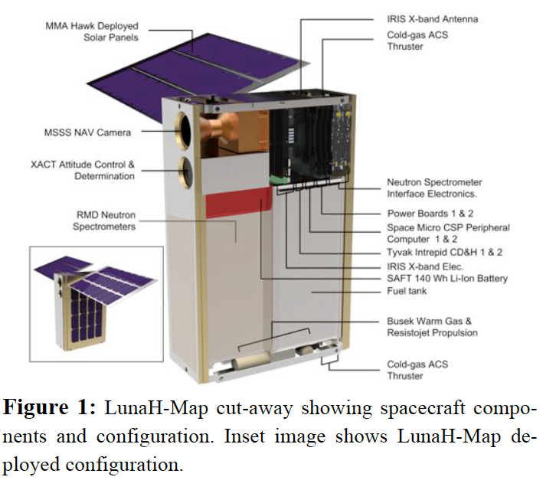
Other EM1 Mission Complimentarity
Lunar Flashlight: Detect surface ice for PSRs polar region by measuring laser stimulated emission at several ice-associated lines.
LunaH Map: Detect ice in top layer (tens of centimeters) of regolith for PSRs polar region by measuring decrease in neutron flux (anti-correlated with protons) using neutron spectrometer.
Lunar IceCube: Determine water forms and components abundances as a function of time of day, latitude, and lunar regolith properties using broadband point spectrometer.

Slide 8
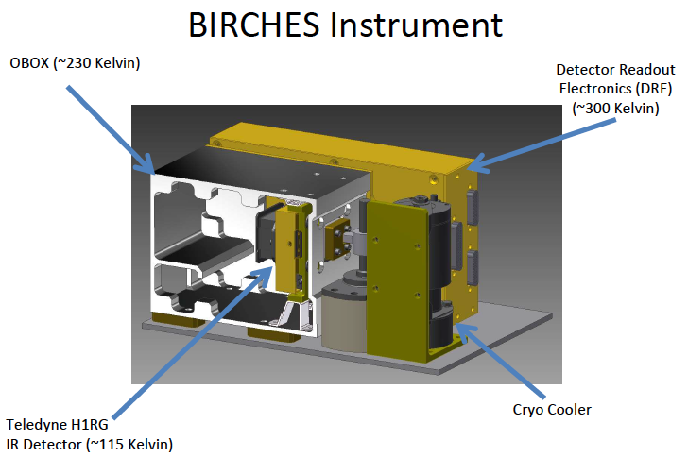
BIRCHES compactness
Property | Ralph | BIRCHES
Mass kg | 11 | 2.5
Power W | 5 | #10-15 W
Size cm | 49 x 40 x 29 | 10 x 10 x 15
# includes 3 W detector electronics, 1.5 W AFS controller, 5-10 W cryocooler

Slide 9
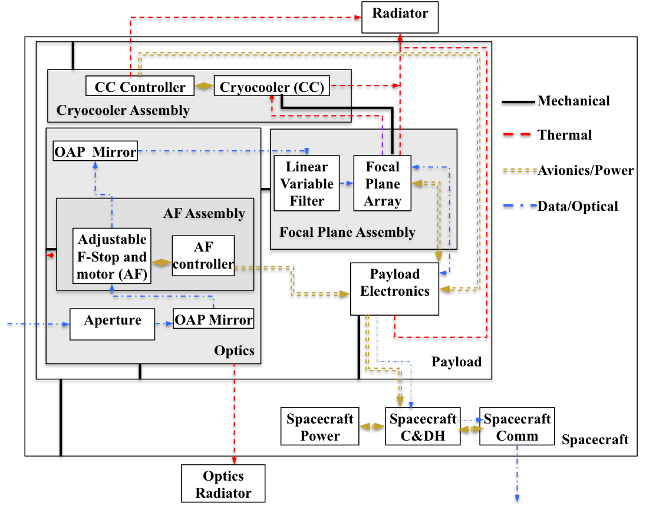
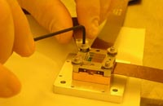
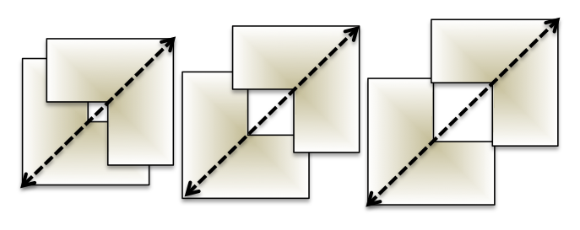
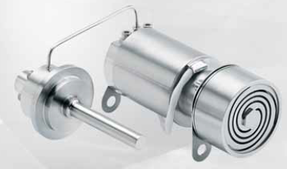
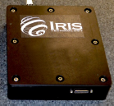
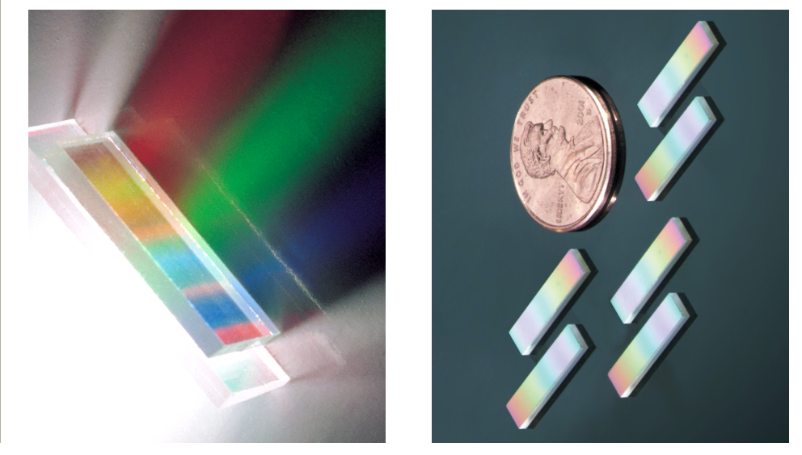
Spectrometer Schematic and Components
BIRCHES utilizes a compact Teledyne H1RG HgCdTe Focal Plane Array and JDSU linear variable filter detector assembly leveraging OSIRIS REx OVIRS.
Adjustable Iris maintains footprint size at 10 km by varying FOV regardless of altitude
COTS AFRL developed AIM SX030 microcryocooler with cold finger to maintain detector at ≤115K and iris controller
JDSU LV filters

Slide 10
BIRCHES Detector Requirements: Obtain spectra from 1 to 4 with 10 nm or better spectral resolution around 3 micron feature
Uses spare OVIRS detector and
three linear variable filters, each with resolving powers, R (λ/Δλ), corresponding to 3 parts of spectrum
Compact H1RG FPA Generic Direct Readout Electronics
Thermal Design:
Passive: 2 radiators including Dedicated optics box (<230K)
Active: Microcryocooler for detector (<115K)
R = 150
13 - 12 nm
R = 200
9 - 14 nm
R = 350
8 - 12 nm

Slide 11
Footprint 10 km in along track direction regardless of altitude, larger in crosstrack direction above 250 km

Slide 12
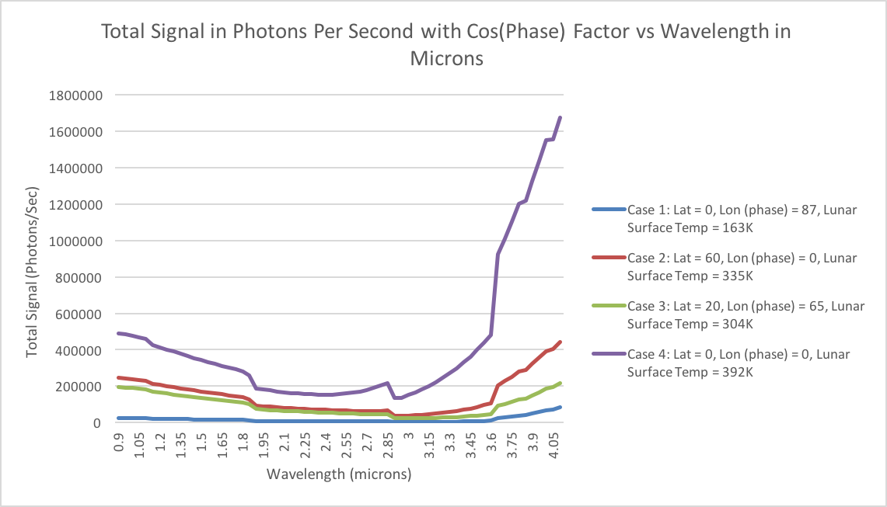
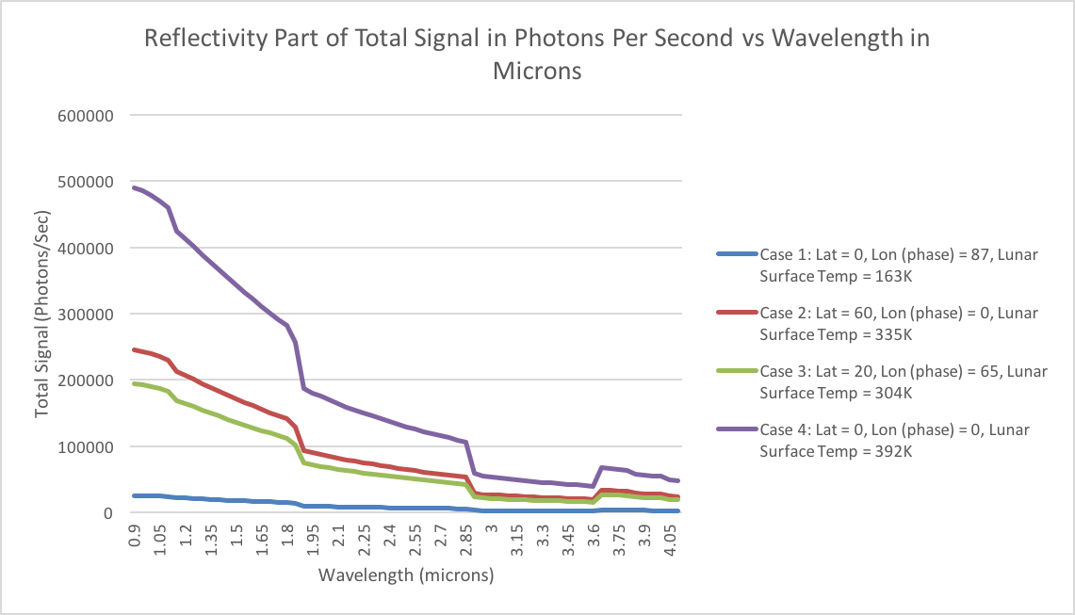
Case | Lat | ToD | Temp K | Total Signal Reflectivity @ 3um photons/sec |  | SNR | Band depth/PPM water
 |  |  |  |  |  |  | 0.1/1000 | 0.05/500 | 0.01/100
1 | 0 | 87 | 163 | 3254 | 2760 | 52 | 276 | 138 | 27
2 | 60 | 0 | 335 | 39045 | 26400 | 162 | 2640 | 1320 | 264
3 | 20 | 65 | 304 | 24279 | 20963 | 145 | 2096 | 1480 | 210
4 | 0 | 0 | 395 | 150777 | 52800 | 230 | 5280 | 2640 | 528

Slide 14
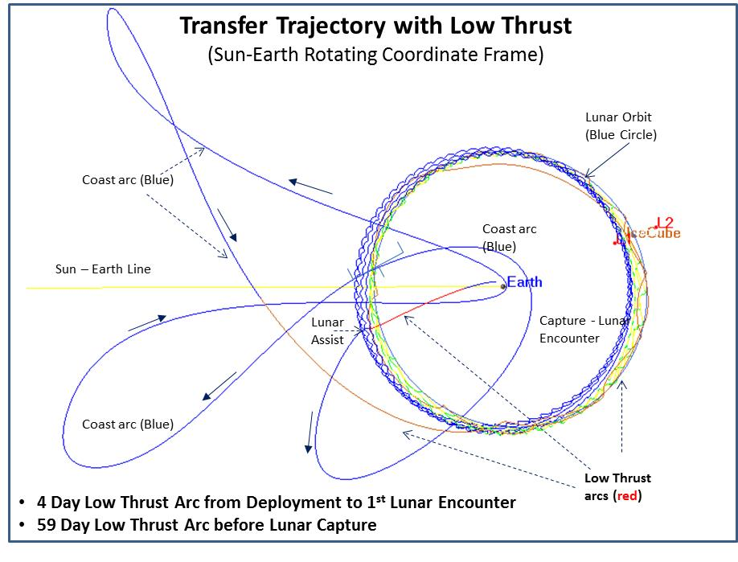
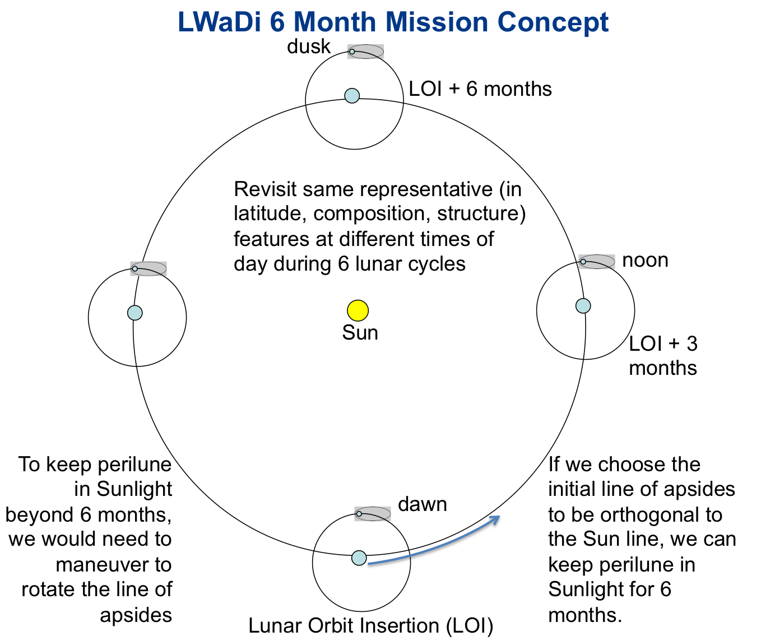
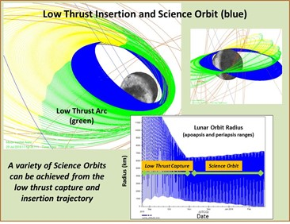
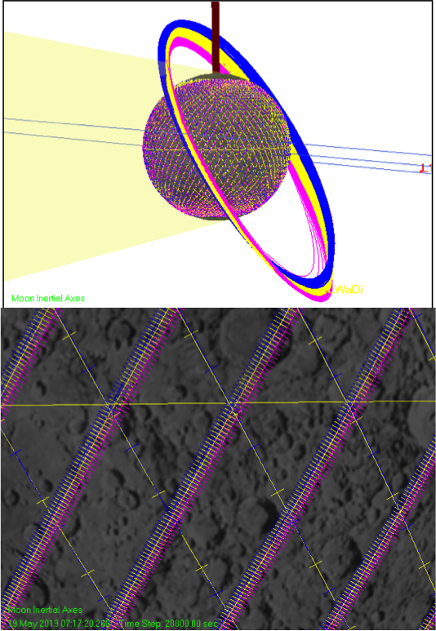

Slide 15
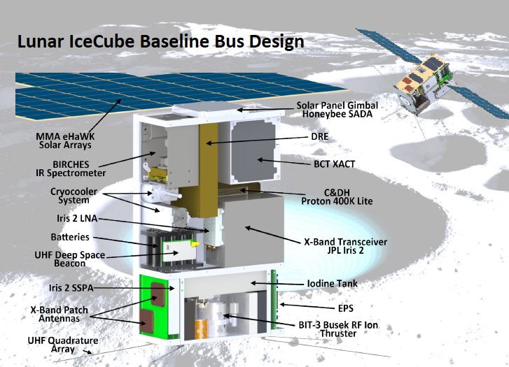

Slide 16
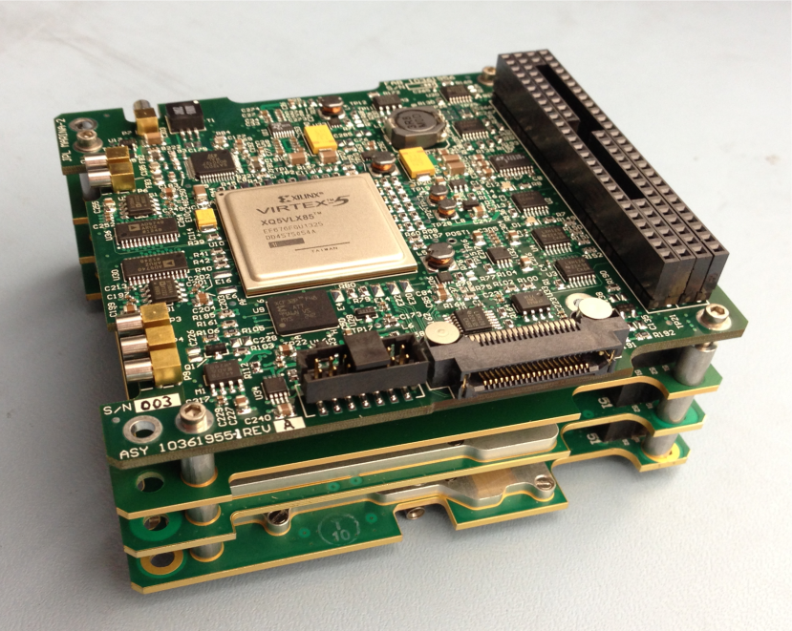
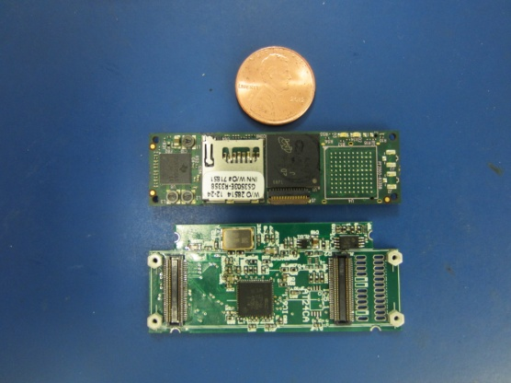
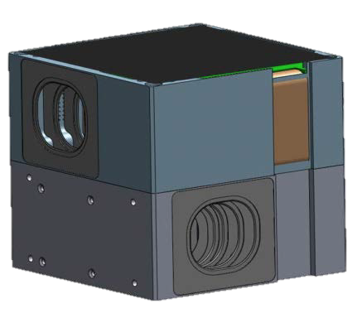
Bus Components
Propulsion: 2U Busek Gimbaled Iodine Ion Propulsion Drive (EP) with external e- source to offset charge build up. Models indicate no contamination problem.
Thermal Design: with minimal radiator for interior the small form factor meant that interior experienced temperatures well within 0 to 40 degrees centrigrade, except for optics box which has a separate radiator. Thermal modeling funded via IRAD work.
Communication, Tracking: X-band, JPL Iris Radio, dual X-band patch antennas. MSU has 21-m dish that is becoming part of the DSN. Anticipated data rate ~ 50 kb/s
C&DH: very compact and capable Honeywell DM microprocessor, at least one backup C&DH computer (trade volume, complexity, cubesat heritage, live with the fact this hasn’t flown in deep space)
GNC/ACS: Modified Blue Canyon system. Multi-component (star trackers, IMU, RWA) packages with heritage available, including BCT XB1, which can interface with thrusters (trade cost, volume, cubesat heritage, live with the fact this hasn’t flown in deep space)

Slide 17
Current status and issues
Data Access and Archiving: subsidized cubesat tool developed underway for stream-lined pipelining and archiving process.
Volume: A chronic problem. Accommodations needed for instrument for more robust microcryocooler and adjustable field stop controllers and propulsion systems especially.
Very high Vibration and Shock survival in original requirements documents: deployer design will mitigate considerably and original margins were very high
Very large survival temperature range in requirements documents: partially mitigated by ‘rolling’ spacecraft once Orion deployed +1.5 hours)
Radiation issue: Deployment opportunity starts in the second lobe of the Van Allen Belt: 8 to 11 hours to get out…however only relatively small Total Ionizing Dose to deal with.
Communication, navigation and tracking: DSN developing new capabilities for multiplexing communication. Iris version 2 provides much improved bandwidth at expense of power.
Thermal Design: major cubesat challenge. Using dedicated radiator to minimize temperature of optics box <230K. Using microcryocooler to maintain detector <115 K.

Slide 18
Conclusions
IceCube to place an IR spectrometer in lunar orbit to look for surface OH, water, other volatiles
Examine changes in surface volatile content to get at dynamics issues! (like Sunshine et al., 2009 observation)
Utilizes MSU cubesat bus with Busek propulsion and commercial subsystems modified for deep space, GSFC payload and flight dynamics expertise with low energy manifolds to lunar capture, and JPL science PI and deep space communication expertise
Creating a tailored solution with a standard platform

Slide 19
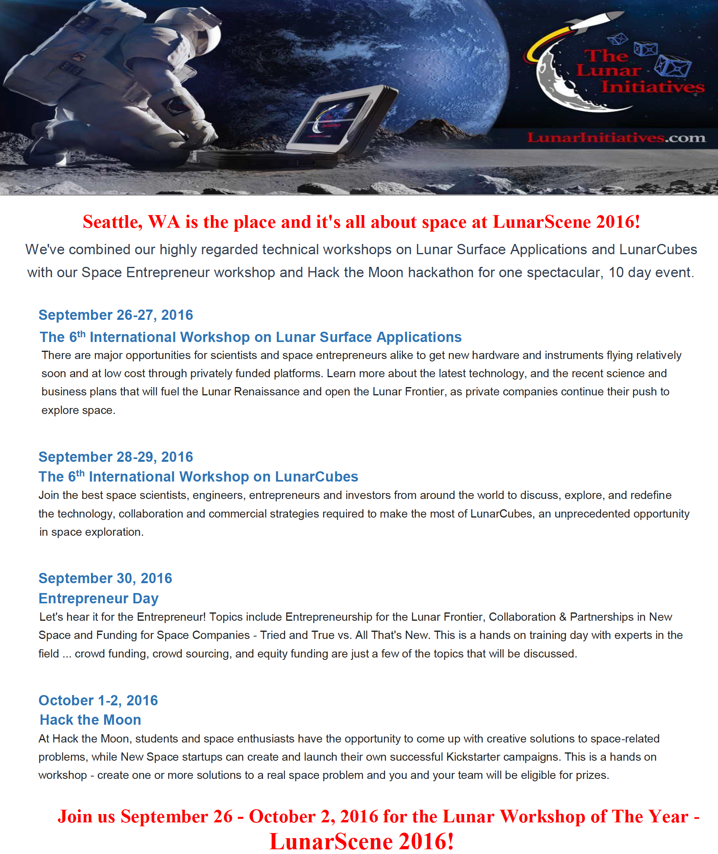
Questions?
www.lunarworkshops.com
pamela.e.clark@jpl.nasa.gov

