Slide 1
Planetary Science Cubesats
Jonathan A. R. Rall
August 4, 2016

Slide 2
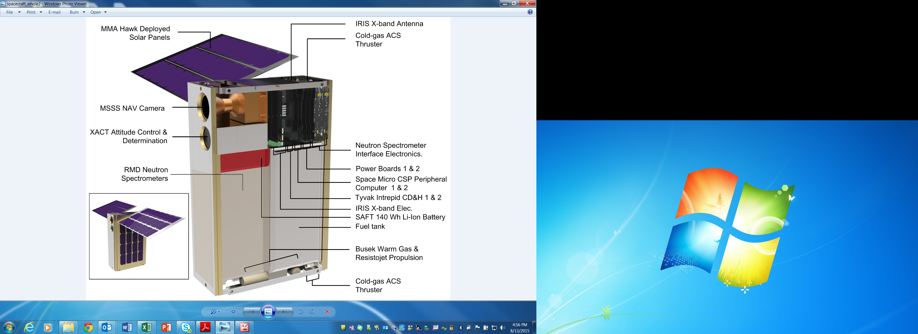
Lunar Polar Hydrogen Mapper (LunaH-Map )
PI: Craig Hardgrove
ASU School of Earth and Space Exploration
Small Innovative Missions for Planetary Exploration (SIMPLEx-2014) – New Awards in FY15
CubeSat Particle Aggregation and Collision Experiment
(Q-PACE)
PI: Josh Colwel
University of Central Florida

Slide 3
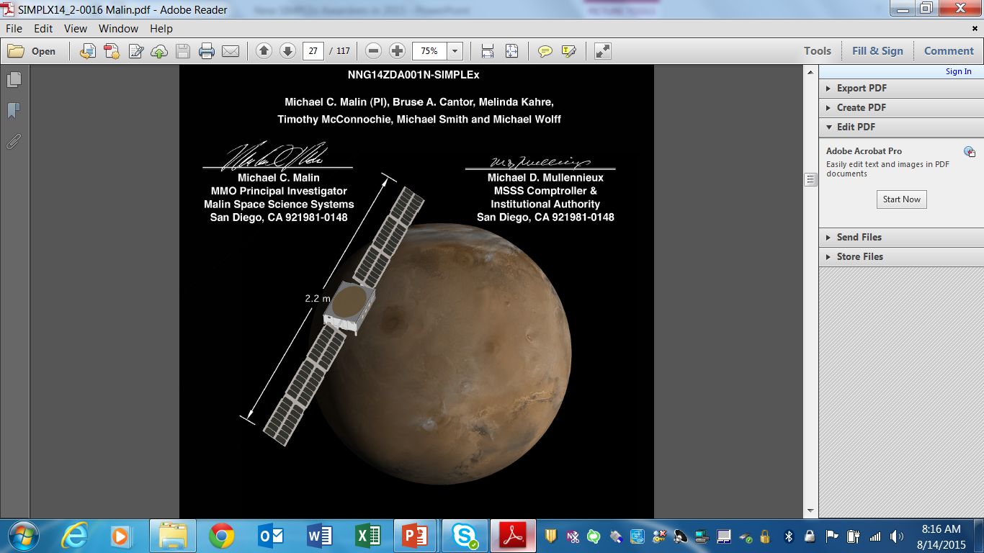
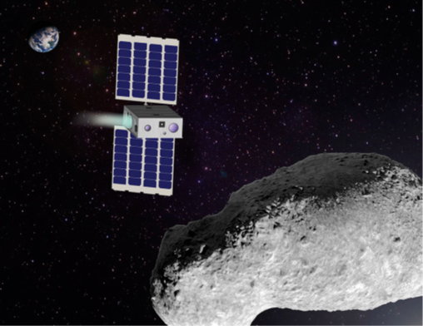
SIMPLEx Cubesats
Approved for Tech Development (1 year) Study ONLY
Mars Micro Orbiter
PI: Michael Malin
Malin Space Science Systems
Diminutive Asteroid Visitor using Ion Drive (DAVID)
PI: Geoffrey Landis
NASA Glenn Research Center
Hydrogen Albedo Lunar Orbiter (HALO)
PI: Michael Collier,
NASA GSFC

Slide 4
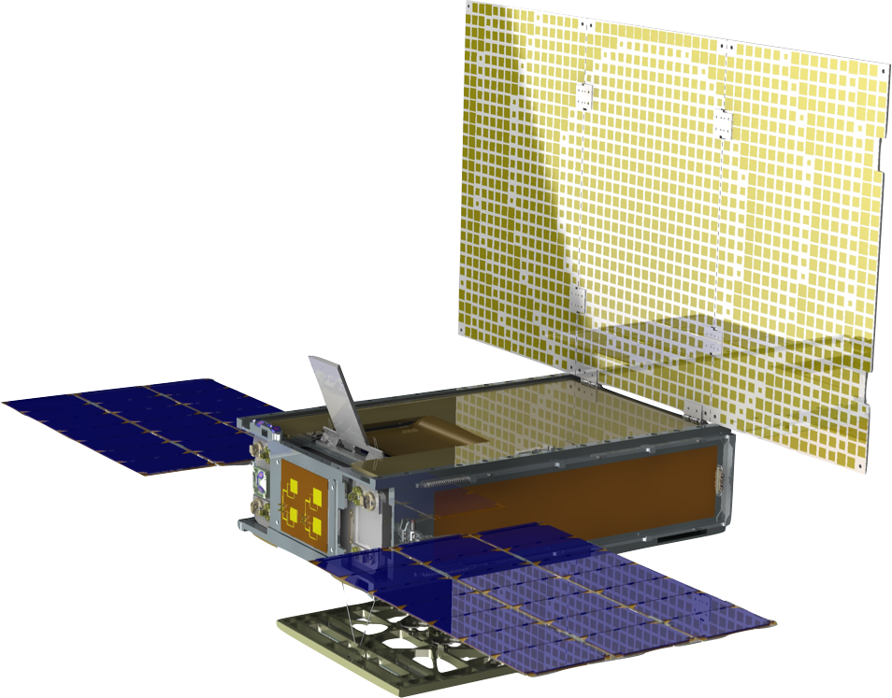
Mars Cube One (MarCO)
MarCo is a 2-spacecraft mission to accompany the Discovery InSight mission to Mars
They will provide real-time data relay during the landing phase
Built by JPL to the 6U-cubesat form factor utilizing some of the sub-systems developed from other cubesats
They feature two deployable solar arrays
Deployable X-band antenna, and an UHF antenna. These provide an 8 kbps UHF link from InSight to MarCO and an 8 kbps X-band link from MarCO to the Deep Space Network (DSN).
The MarCO satellites will be deployed from the Atlas-5(401) launch vehicles upper stage and fly on their own to Mars, performing trajectory correction maneuvers

Slide 5

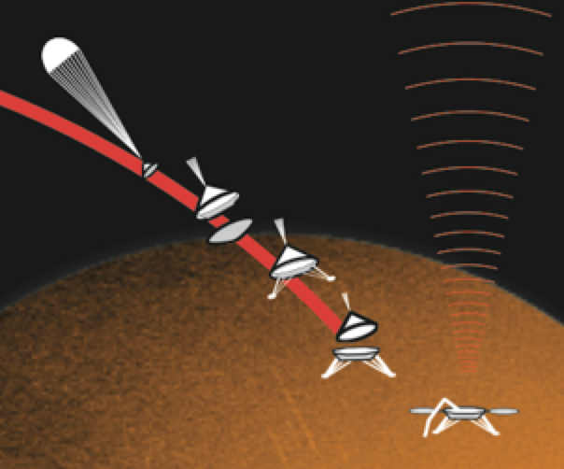
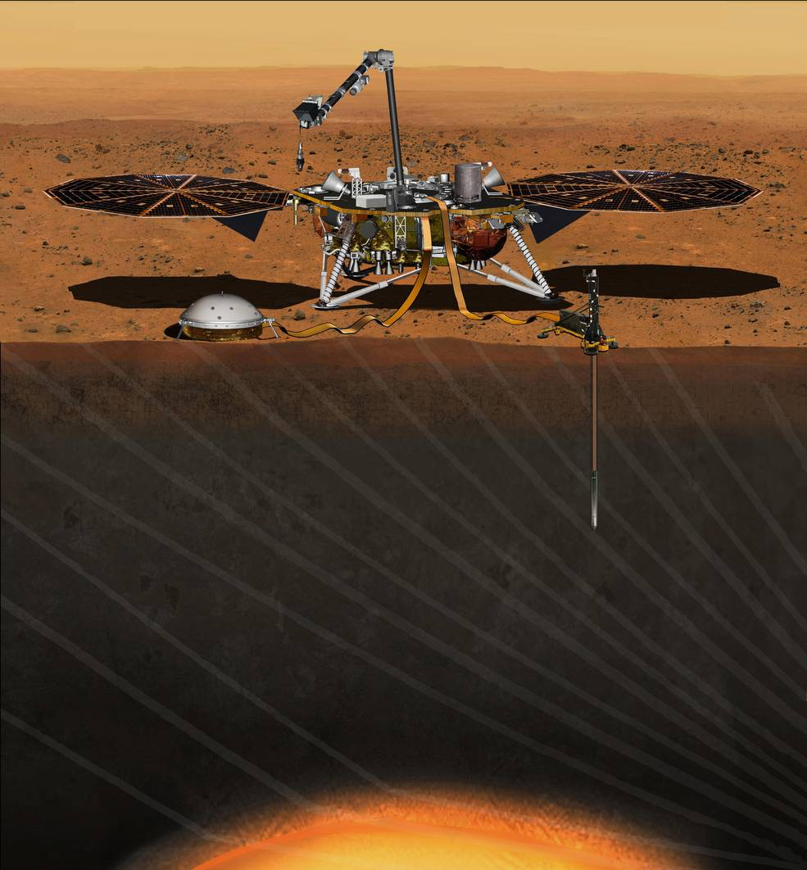

MarCO
Mars Cube One
TCM 5
Mars
TCM 4
TCM 3
6.5 Month Cruise
Entry, Descent, and Landing
Of InSight Mission
TCM 2
March 2016
TCM 1
Earth

Slide 6
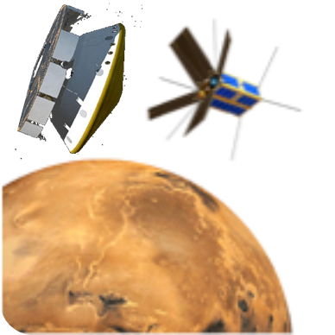
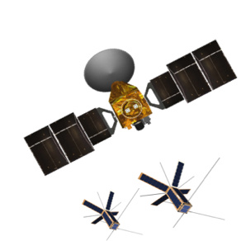
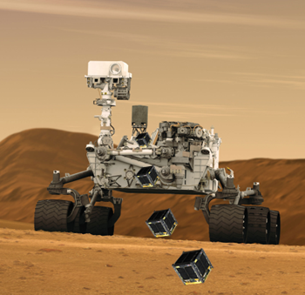
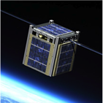
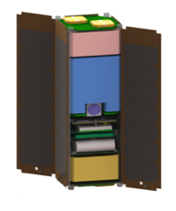
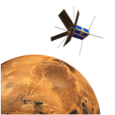
Ways to deliver CubeSats to Mars
Deploy CubeSat near Earth …
from
a launch vehicle in Earth orbit / GTO
  Many commercial and US government GTO launch opportunities
  Additional propulsion from Earth GTO to Mars
  Fly-By or MOI by Aerocapture or advanced propulsion
Deploy CubeSat during cruise…
from
a Mars-bound launch vehicle
  Co-manifest with a Mars mission launch
  Cruise navigation to Mars and comm by CubeSat
  Fly-By or MOI by Aerocapture or advanced propulsion
Deploy CubeSat at Mars arrival …
from
a Mars Lander or Orbiter Mothership
  Mother ship provides cruise services
  Fly-By or MOI by Aerocapture or advanced propulsion
Deploy CubeSat in Mars orbit …
from
a Mars Orbiter Mothership
  Mother ship provides cruise services
  Mother ship provides orbital insertion and DTE comm.
“Barnacle” Mode
CubeSat attached to Mars Rover Mothership
  Mother ship provides cruise services
  Mother ship provides EDL and surface ops power, comm
  Deploy to hazardous locations
Self-contained spacecraft
Best Options
Heavy reliance on mothership
Hard (implementation challenge for CubeSat) Easy
Easy (implementation challenge for host mission) Hard

Slide 7
Cubesats At Mars
Current Mars cubesats: MarCO (2) used to monitor InSight during its entry, decent, and landing (EDL) launch in 2018
Next SIMPLEx ROSES call will focus on a future Mars mission
  JPL has developed a one cube com system for MarCO that has X-band & UHF “Electra” services that will be GFE to proposers
Cubesats at Mars require a way to get there
  Hitching a ride should be a baseline plan that requires each cubesat to get into orbit on their own
  New orbit insertion techniques (Weak Stability Boundary) can be thoroughly tested
Upcoming Potential Opportunities include:
  In 2020: Mars Rover, Space-X, ESA/ExoMars, UAE/Hope
  In 2022: JAXA/MMX, Space-X . . .
Future Plans: For the next Planetary Decadal, a set of well defined science objectives for cubesats at Mars should be delineated

Slide 8
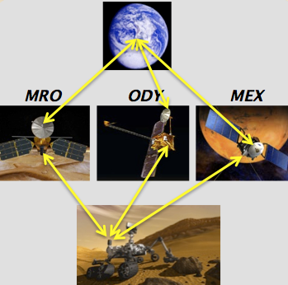
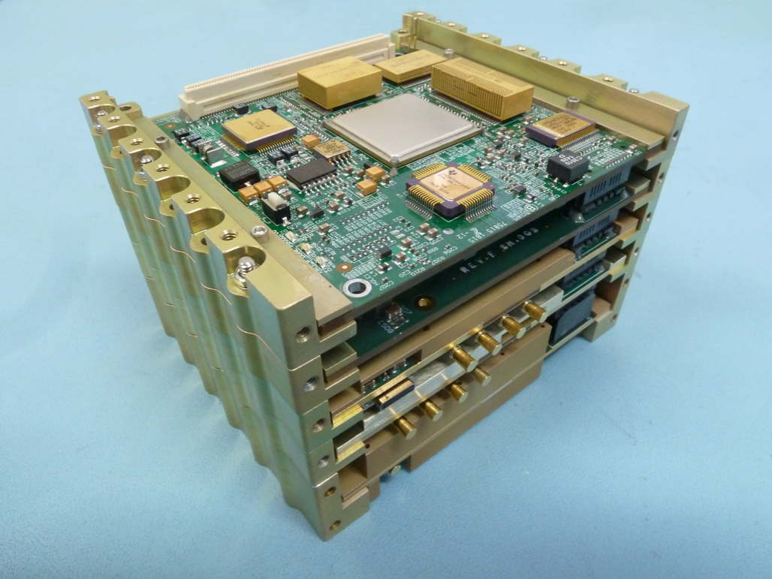
Future Cubesats at Mars
High Rate
Return
For the next SIMPLEx call, the MarCO JPL Iris radio will be provided as government furnished equipment
  X-band transmit and receive capability
  Two-way UHF communications for operating in the Mars system
UHF communication is used in the Mars system in order to support higher data rates
Transmit and receive data rates will vary depending on range, antenna gain and pointing for both X-band and UHF.
UHF
Links
Iris Communication Cube

Slide 9
New Technique to get into Orbit at Mars
Perform special maneuvers to start a “capture” transfer into Mars orbit (weak stability boundary)
Arrive at Mars into a low altitude orbit with no capture delta-V (saves up to ~25% fuel)
Cubesats are a perfect low cost way to test this concept potentially providing a huge benefit for future Mars Missions
Sun
Direction
Sun
L1
L2
L1
L2
Ballistic capture transfer (red) as it goes to automatic capture into orbit (blue) about Mars.
Produces a capture altitude of 500 km (~MRO altitude)!
Mars
(Belbruno, Topputo, July 2014)

Slide 10
What about the rest of the Solar System?
Upcoming ROSES 2016 opportunity: “Planetary Science Deep Space Smallsat Study,”
  This solicitation supports the development of spaceflight mission concepts that can be accomplished using small spacecraft or cubesats.
All future planetary missions will consider having SIMPLEx calls associated with them once launch vehicles have been selected.
  Solicitations for cubesats will be released to provide sufficient development time but not too far in advance that life cycle costs are increased.

Slide 11
Questions?

